Slide 1
Alpha players
MANISH KUMAR SINHA
MUHAMMAD LUQMAN
GOVIND SINGH

Slide 2
MATHEREST 3D

Slide 3
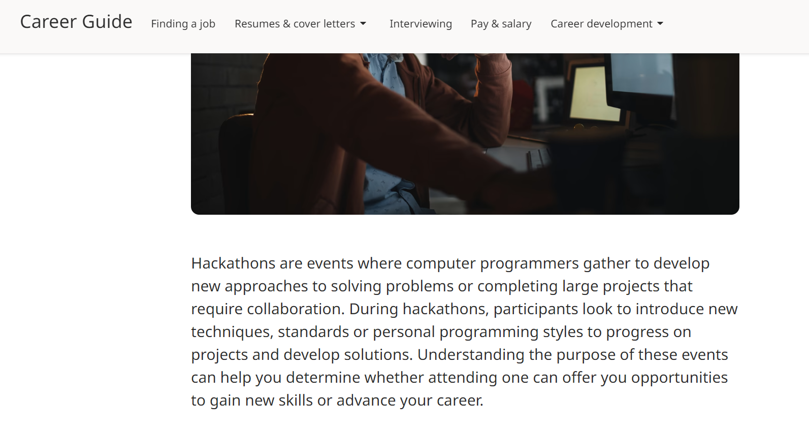
So our first aim is to tackle a problem.

Slide 4
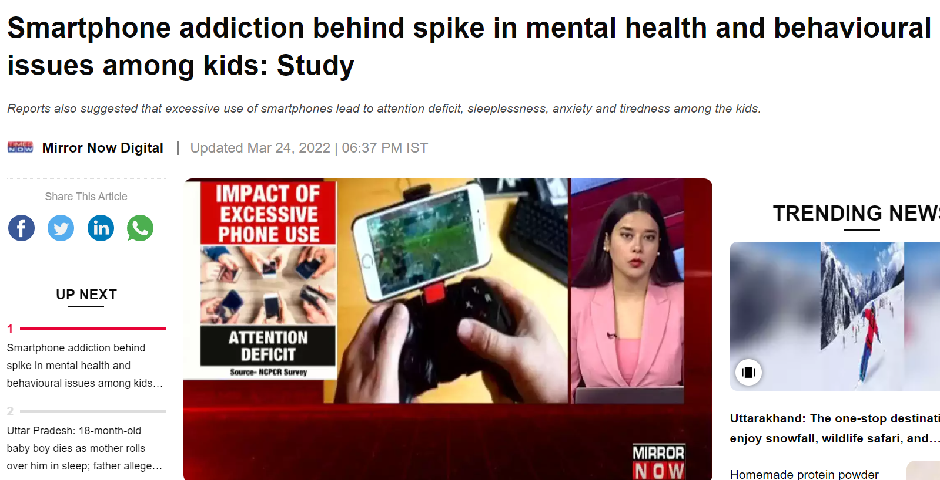
Phone Addiction

Slide 5
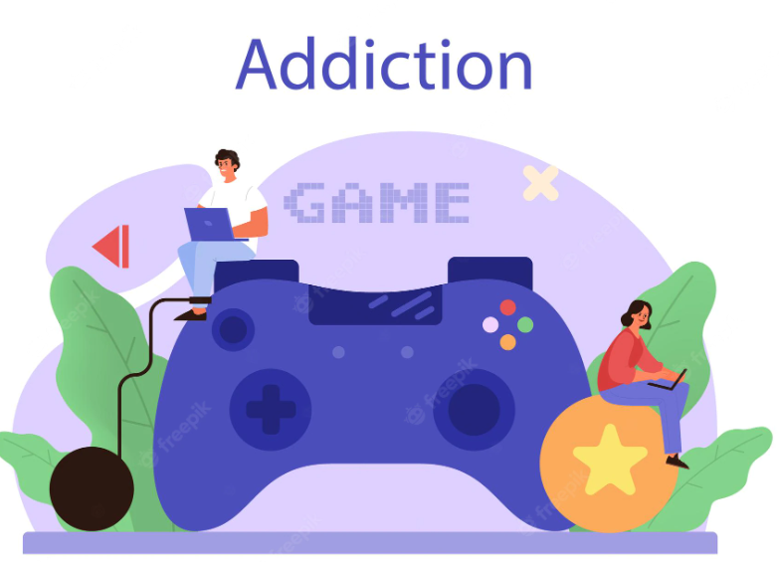
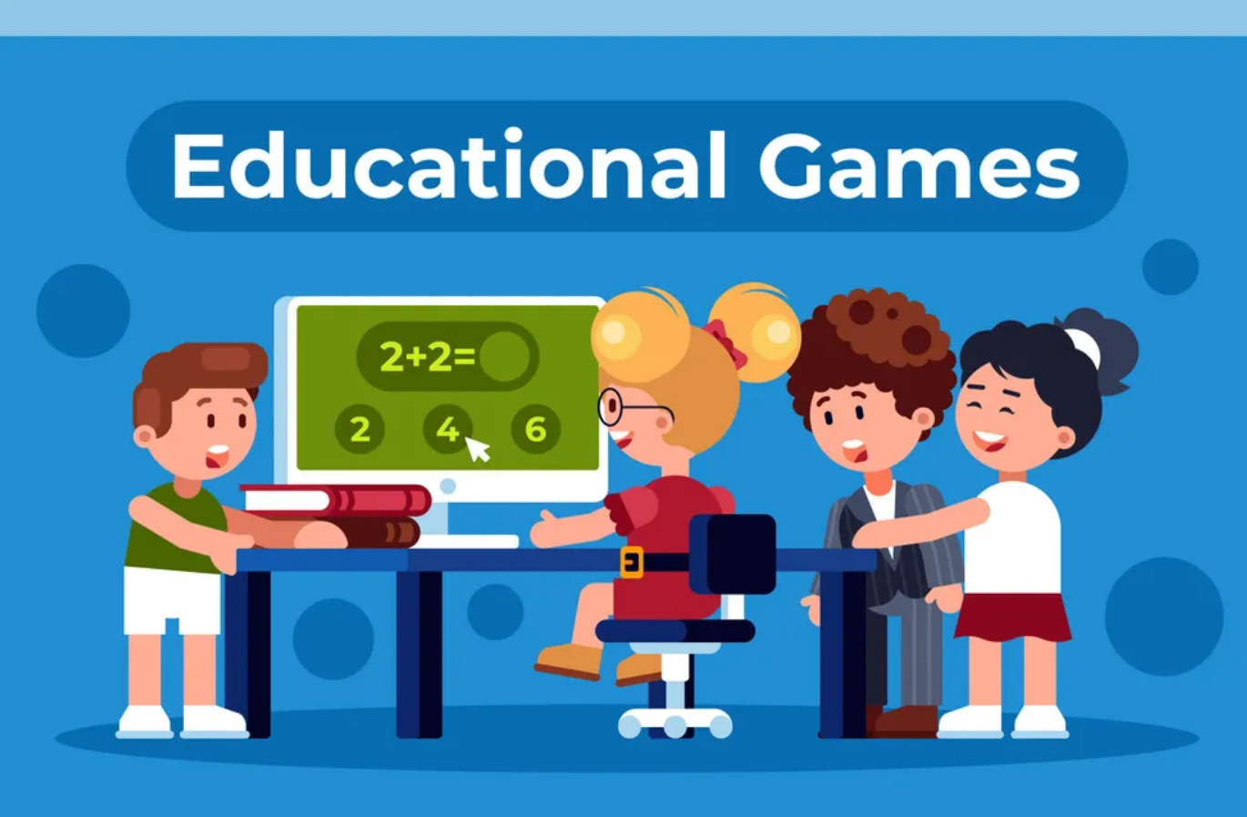
Taking advantage of addiction

Slide 6
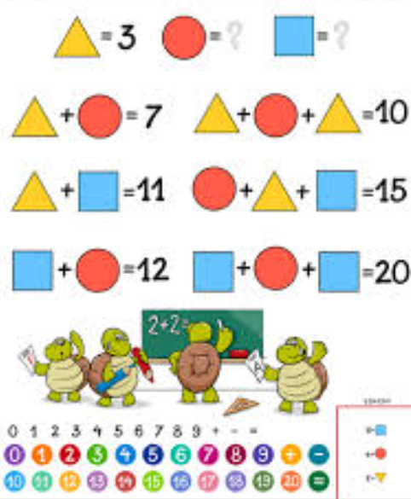
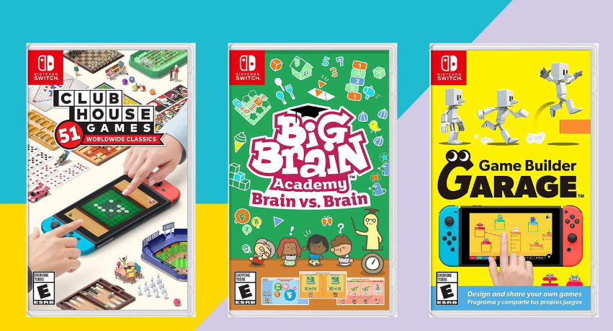
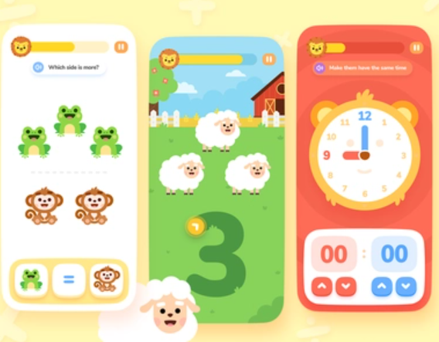
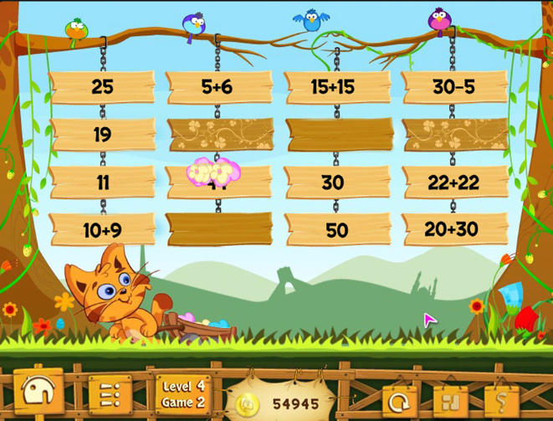
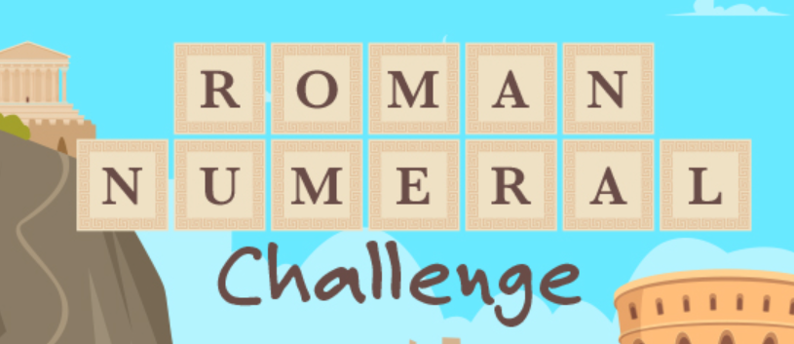

Slide 7
The basis of our project(game)
We are not exactly solving phone addiction, but taking advantage of addiction by redirecting the addiction into something educational.
Educational games are pretty much as an educational platform which makes it a bit boring.
By creating a game with a pinch of education in it, children wont exactly feel as if they are studying.

Slide 8
Lets begin the journey into our project

Slide 9
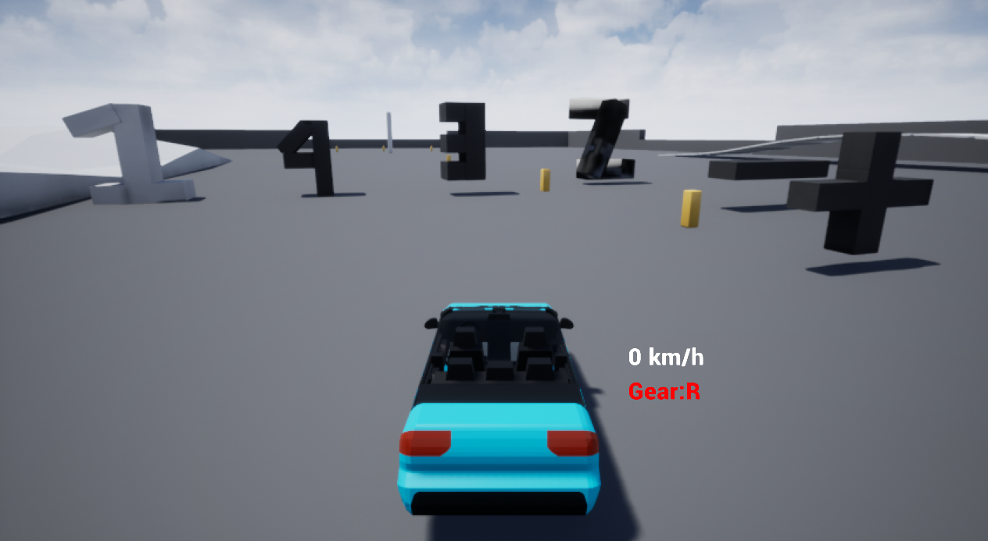
Our 3D game will consist of a car and numbers and signs at the basic level.
The player will pass through the numbers displayed on the screen and the game will proceed as

Slide 10
Gameplay
Player is free to roam anywhere in our game. Its not necessary that the player will have to pass through the numbers. Although he/she wont clear the level by doing so but will surely enjoy it.
By giving this freedom we are enabling the player to enjoy as well as study. This separates our game from other educational game where the player is restrained to only educate themselves. We on the other hand gives the player full freedom.

Slide 11
How our game will work(backend)
The player will pass through the numbers and sign and he/she will either lose or win on the basis of correct maths. Lets further understand it with a basic example.
Lets say the player will first pass through ‘1’, ‘2’ and ‘+’. Then the next element the player should pass through in order to win is ‘3’. Only then the player will win the game otherwise will lose in every other case.

Slide 12
Scope of our game.
we can target other subjects like chemistry by replacing the numbers with symbols of elements and that way player can learn chemical equations.
We can add other entertaining elements like missiles, blast to make the game more engaging.
If the player fails to pass the level then a relevant youtube video will be opened so that the player can clear his/her doubts.
Difficulty level can easily be increased, our game is just focusing on the basics as of now.
We can even introduce a character in our upcoming levels and even introduce spaceships so that this game is not just restrained to cars but even characters and space.

Slide 13
Monetization
The most easiest way to earn is through ads.
Ads are annoying to most players so they can spend money to stop the ads.
We can sell skins of cars or other assets that will be added further down the line.
We can even create festival specific environment which will be limited time deals.
We can create a premium pass on monthly basis.

